Slide 1
Introduction to Statistical Method

Slide 2
Course No: DSECL ZC413
Course Title: ISM
WEBINAR 3

Slide 3
Topics – Webinar
Normal Distribution
Null and Alternative Hypothesis
Testing of Hypothesis ( z- test and t test )
Chi-Square test

Slide 4
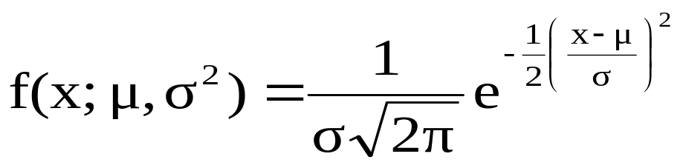


Normal Distribution
A continuous random variable X which assumes all possible values in
the entire real space, i.e., -∞<x<∞ is said to follow normal distribution with two parameters such as mean μ and variance σ² if it has the probability density function given by
$$−∞<x<∞$$
$$−∞<μ<∞ , σ>0$$

Slide 5
Normal Distribution
The graph of normal distribution is called normal curve.
It is bell shaped and symmetrical about mean
Area under normal curve represents the total population.
Mean, Median, Mode of normal distribution coincides.
Area under the normal distribution curve is 1

Slide 6

Normal Distribution
If X is a normally distributed random variable then is also a random variable following standard normal distribution with
The mean (μ) = 0
The standard deviation (σ) = 1

Slide 7
Normal Distribution
Example-1
1. Salaries of 500 employees in a company follows normal distribution with an average salary of 20(lakhs per annum) and variance of 4(lakhs). Then find the number of employees
whose salary is above 22(lakhs)
whose salary is below 16(lakhs)
Whose salary is between 16 and 22(Lakhs)
Are there any inconsistencies observed in this data?
.

Slide 8
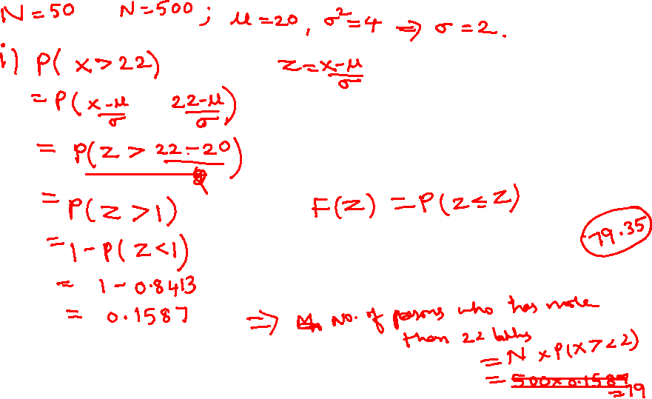
Normal Distribution
Solution-1
.
Notes:
P(z<-2)=1-P(Z<2)=1-0.9772=0.0228

Slide 9
Normal Distribution
Solution-1
Notes:
P(-2<z<1)= F(1) – F(-2) =F(1)-(1-F(2))=0.8413-(1-0.9772)=0.8185

Slide 10
Normal Distribution
Solution-1
Notes:
P(-2<z<1)= F(1) – F(-2) =F(1)-(1-F(2))=0.8413-(1-0.9772)=0.8185

Slide 11
Normal approximation to binomialDistribution
2.
Find the probability that out of 100 patients between 84 and 95 inclusive will survive heart-operation given that the chance of survival is 0.9
Notes:
Normal approximation when np>=5 and nq>=5

Slide 12
Normal approximation to binomialDistribution
Solution-2

Slide 13












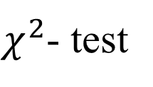





Testing of Hypothesis

Slide 14
Steps involved in Testing of Hypothesis
State null and alternative hypotheses
Specify the level of significance ‘α’
Define the probability distribution the data follows
Compute the test statistic based defined population
Define the rejection criteria/critical regional
Conclusion

Slide 15
Parametric tests
Large Sample Test
n ≥ 30
It is assumed that the data do follow some probability distribution which is
characterized by any parameters.
Standard Normal Test
Z-Test
Small Sample Test
n < 30 (Generally)
Unpaired t-Test
Student’s t-test
Paired t-Test
1-way ANOVA
Analysis of Variance
2-way ANOVA

Slide 16
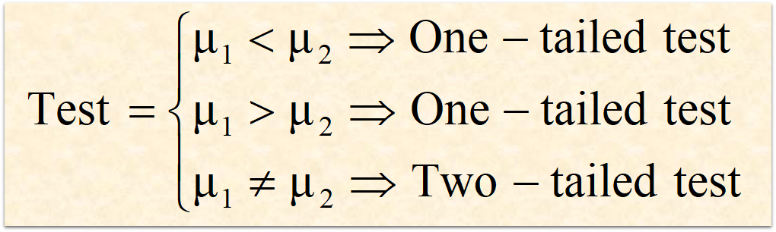
a. 5% level of significance (Critical value is 1.645 for one tailed 1.96 for two tailed )
b. 1% level of significance (Critical value is 2.331 for one tailed and for two tailed 2.58)

Slide 17
Test of Hypothesis single mean Example -1
3. A medical research team is investigating the benefits of a new surgical treatment. One of the claims is that the mean recovery time for patients after the new treatment is less than 96 hours. How would you write the null and alternative hypotheses.

Slide 18
Test of Hypothesis single mean Example -2
4. In auto racing, a pit stop is where a racing vehicle stops for new tires, fuel, repairs, and other mechanical adjustments. The efficiency of a pit crew that makes these adjustments can affect the outcome of a race. A pit crew claims that its mean pit stop time (for 4 new tires and fuel) is less than 13 seconds. A random selection of 32 pit stop times has a sample mean of 12.9 seconds and a standard deviation of 0.19 second. Is there enough evidence to support the claim at 1% level of significance. Use a P-value
The p-value is a fundamental concept in hypothesis testing — it helps you determine the strength of your evidence against the null hypothesis.
It tells you how unusual or rare your sample result is if the null hypothesis is correct.
small p-value (typically ≤ 0.05): Strong evidence against the null hypothesis — you may reject H0

Slide 19
Test of Hypothesis single mean Solution-2
Notes:
F(-2.98)=1-F(2.98)= 1- 0.9986=0.0014. so P=2(0.0014)=0.0028 Since alpha > p reject H0.

Slide 20
Test of Hypothesis single mean Solution-2
Notes:
F(-2.98)=1-F(2.98)= 1- 0.9986=0.0014. so P=2(0.0014)=0.0028 Since alpha > p reject H0.

Slide 21
Test of Hypothesis single mean Example: 3
5. The National Institute of Diabetes and Digestive and Kidney Diseases reports that the average cost of bariatric (weight loss) surgery is about $22,500. You think this information is incorrect. You randomly select 30 bariatric surgery patients and find that the average cost for their surgeries is $21,545 with a standard deviation of $3015. Is there enough evidence to support your claim at 5% level of significance Use a P-value.

Slide 22
Test of Hypothesis single mean Solution: 3

Slide 23
Test of Hypothesis single mean Solution: 3

Slide 24
Test of Hypothesis single mean Example. 4
6. A sample of 30 milk carton provides a sample mean of 505 ml. The population standard deviation is believed to be 10 ml. Perform a hypothesis test, at 0.05 level of significance on population mean 500 ml. and to help determine whether the filling process should continue operating or to be stopped and corrected. Use P-value also to validate the hypothesis.

Slide 25
Test of Hypothesis single mean Solution: 4

Slide 26
Test of Hypothesis single mean Solution: 4

Slide 27
Test of Hypothesis single mean Example: 5
7. Employees at a construction and mining company claim that the mean salary of the company’s mechanical engineers is less than that of one of its competitors, which is $68,000. A random sample of 30 of the company’s mechanical engineers has a mean salary of $66,900 with a standard deviation of $5500. At 5% level of significance test the employees’ claim.

Slide 28
Test of Hypothesis single mean Solution: 5

Slide 29
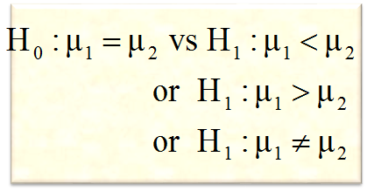
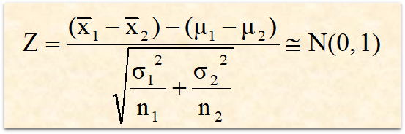
Parametric tests: Z-test for testing (µ₁ - µ₂)
1
State null and alternative hypothesis
2
Specify the level of significance ‘α’
3
Standard Normal Distribution
4
Compute the test statistic
5
Define the critical region/ rejection criteria
6
Conclusion
Note: Assuming population variances are known

Slide 30
Parametric tests: Z-test for testing (µ₁ - µ₂)
Example 1:
8. A taxi company is trying to decide whether to purchase brand A or brand B tyres for its fleet of taxis. To estimate difference in two brands, an experiment was conducted using 30 and 40 respectively for brand A and brand B. The tyres are run until they wear out.
Test at 5% level of significance is there any significant difference between the two brands of tyres

Slide 31
Parametric tests: Z-test for testing (µ₁ - µ₂)
Suppose some data is given below, now how will you decide to purchase the brand?
Brands | Sample size | Mean (kms) | SD (kms)
A | 30 | 38600 | 5000
B | 40 | 35450 | 6100

Slide 32
Test of Hypothesis two mean
Solution .1

Slide 33
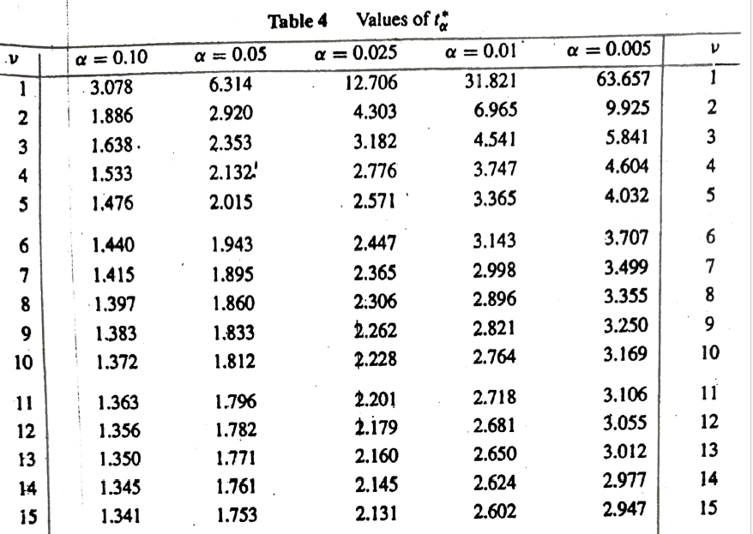
Topics – Webinar

Slide 34
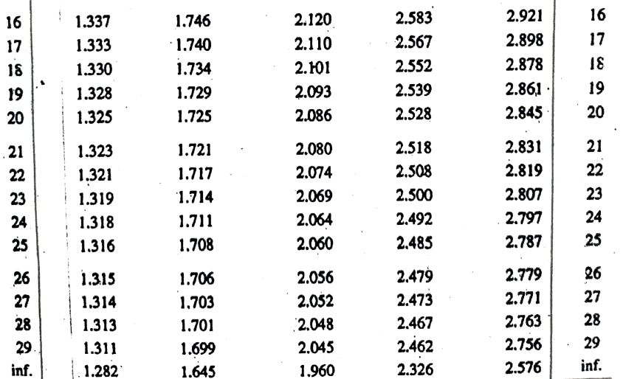
Topics – Webinar

